Slide 1
Realtime Help Desk System Via Video Call

Slide 2
Supervisor
Team leader
Nguyễn Viết Công Hậu
Member
Member
Lưu Nguyễn Ngọc Thư
Nguyễn Ngô Đức Khải
Mr. Nguyễn Huy Hùng

Slide 3
Outline
Introduction
Solution
Conclusion
- Problem & Scenario
- Solution
- Special function
- Web Service Architecture
- Front-end Application Architecture
- System Architecture
- Advantages & Disadvantages
- Future Plan
- Algorithms
- Firebase
- WebRTC

Slide 4
INTRODUCTION

Slide 5

Problem
I can’t ask them at this time
Friends
not found
That IT guy is not friendly
How to solve the problem?!

Slide 6
Scenario
Have IT problem! What to do?!
Ask a friend
They can help
They cannot help
They’re so helpful
Problem solved
Ask an random IT guy
They’re not helpful
Google it!
Answer found
Answer not found

Slide 7


Idea
OK! I can help!
Found suitable assignees
Request for Help
Connect & Help requester solve the problem
Notes:
Có 2 trường hợp chuyển request đến cho staff giải quyết:
Trong chủ đề mà người dùng yêu cầu, hoàn toàn không có chuyên gia nào đăng ký
Trong số những chuyên gia tốt nhất được con bot assign, không có chuyên gia nào online hoặc các chuyên gia đó đều từ chối nhận request
Lưu ý: thường trong những trường hợp trên, staff sẽ decline request ấy

Slide 8
Special Function
User’s
Request for Help
Chat
Call
Video call
Expert’s
Decline request
System’s
Auto assign request
Accept request
Share screen

Slide 9
Roles
User
A man who has IT problems that need to resolve
Expert
A man who has expertise could resolve user problems.

Slide 10
Solution

Slide 11

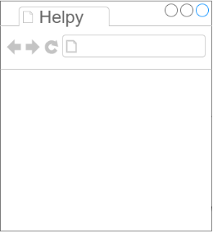


System Architecture
SYSTEM
React.js Front-end Server
DB
Browser
Back-end/Staff Webapp Server
Controller
View
Apache 2
Worker Service
Repository
Business Logic
Service
Signaling Server
(WebRTC Node.js Socket.io)
Redis
Firebase Realtime Database

Slide 12
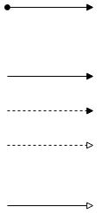
Web Service Architecture
Front-end Application
1. Send HTTP Request
7. Send HTTP Response
W
Web Service
RESTful Webservice API Controller Action
2. Call Service Method
6. Return
Repository
3. Call
Business Logic Service
5. Return
4. Manipulate
DB

Slide 13
Front-end Application Architecture
Front-end Application
5. Notify State Changed
React.js View
1. Create
Redux Store
State
Action
2. Call
4. Update
Dispatcher
3. Dispatch
Reducer
Middleware
2.1 Sent HTTP Request
2.2 Send HTTP Response
Web Service

Slide 14
ALGORITHM: APPLY COLLABORATIVE FILTERING TO ASSIGN SUITABLE EXPERTS TO REQUESTS

Slide 15



Problem of matching experts to requests
Assign priority 1
Auto Assign
Weighted score
Request for Help
Worker Service
Assign priority 2

Slide 16
solution
Apply Collaborative Filtering :
Step 1: Build a dataset that is the feedback score users give to experts each supporting time.
Step 2: Find similar users to the user asks the request by look for users that has similar in feedback scores with the user.

Slide 17


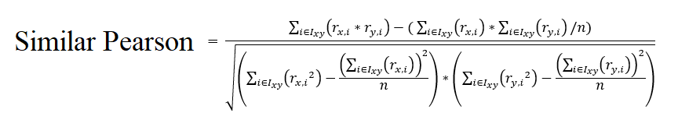
Where:
- Ixy is the set of common experts that the 2 (two) users have given scores.
- r_{x} the set of common experts’ score given by user 1.
- r_{y} the set of common experts’ score given by user 2.
- n the numbers of common experts that 2 (two) users have given scores.

Slide 18
solution
Step 3: Suggest experts for the user’s request by his or her other similar users. These experts are the experts that the user has not given scores yet.

Slide 19
DEMO: AUTO-ASSIGN EXPERT

Slide 20
Flowchart: Conversation
Start
User and expert participate a conversation
User and expert selects interaction method
No
No
User want
to close conversation
Valid feedback?
User fills feedback info
Yes
Start method
Yes
End method
End
Notes:
Khai

Slide 21
How to get dataset?

Slide 22
is a
User
asks
is a
Expert
gives
User Feedback
Conversation Participant
Request
assigned
has
has
Conversation
has

Slide 23
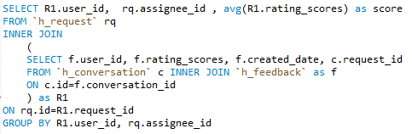
How to get dataset?

Slide 24
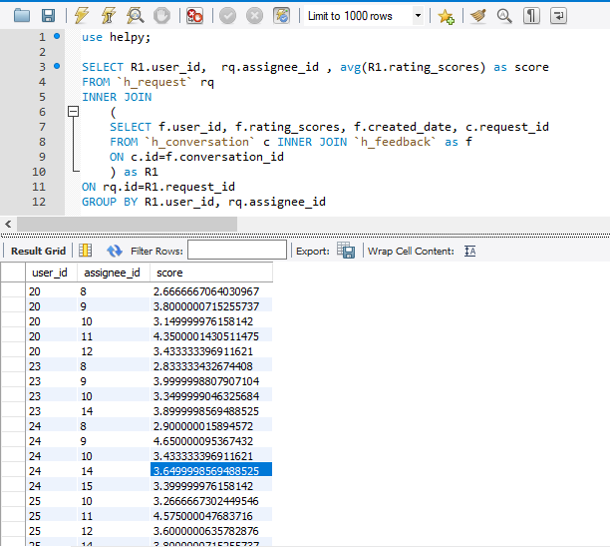
User | Expert | Score
20 | 8 | 2.666667
20 | 9 | 3.8
20 | 10 | 3.15
20 | 11 | 4.35
20 | 12 | 3.433333
23 | 8 | 2.833333
23 | 9 | 4
23 | 10 | 3.35
23 | 14 | 3.9
24 | 8 | 2.9
24 | 9 | 4.65
24 | 10 | 3.433333
24 | 14 | 3.65
24 | 15 | 3.4
25 | 10 | 3.266667
25 | 11 | 4.575
25 | 12 | 3.6
25 | 14 | 3.8
Sample Dataset

Slide 25
Similar Pearson with User 25
20 | 0.9998
23 | 1
24 | 1
Score for expertise field 1's experts
 | 8 | 9 | 10 | 11
20 | 2.666666706 | 3.800000072 | 3.15 | 4.35
23 | 2.833333433 | 3.999999881 | 3.35
24 | 2.900000016 | 4.650000095 | 3.433333
total | 6.577777778 | 12.45000005
sim sum | 2.999803214 | 2.999803214
total/sim sum (weighted score) | ~2.8 | ~4.15

Slide 26
Flowchart: auto assign request
Start
Ask user to provide valid info
No
Valid info?
User makes request
User provides info
Yes
No suitable experts left?
Set request status to pending
Yes
Find suitable expert
No
Expert accept request?
End
Auto assign request
Yes
No
Notes:
Giới hạn: 10 từ trở lên

Slide 27


Slide 28
INTRODUCTION TO fIREBASE REALTIME DATABBASE
Firebase is a mobile and web application development platform.
Firebase Realtime Database
No-SQL Cloud Database
Enables to store & sync data

Slide 29
DEMO: CONVERSATION COMMUNICATION VIA FIREBASE REAL-TIME DATABASE

Slide 30
User
is a
adds
Message
Conversation Participant
has
Conversation
has

Slide 31
Chat Flow
Start
User sends message
Yes
User
input new message?
Valid message?
Notify invalid message
No
No
Yes
Can connect?
Notify cannot send message
No
Yes
End
Message sent
Notes:
Khai

Slide 32
Browser
Back-end/Staff Webapp Server
DB
Controller
Repository
Business Logic
Service
Firebase Realtime Database

Slide 33


Slide 34
INTRODUCTION TO WEBRTC
WebRTC ("Web Real-Time Communication")
A collection of protocols & API enables real-time communication over peer-to-peer connections.
Allow users’ browsers to enable applications such as video conferencing, file transfer, chat, or desktop sharing without installing plugins.
Standardized by the World Wide Web Consortium (W3C).

Slide 35
WEBRTC DESIGN
WebRTC uses Real-time Transport Protocol to transfer audio and video.
Major Components:
getUserMedia : to access resources such as camera, microphone, screen to capture media.
RTCPeerConnection : to set up audio/video calls.
RTCDataChannel: enable to transfer (share) data via peer-to-peer connections.

Slide 36
WEBRTC IN OUR SYSTEM
User’s Browser
Expert’s Browser
Signaling Server
(WebRTC Node.js Socket.io)

Slide 37
DEMO: CALLING VIA WEBRTC

Slide 38
User
is a
adds
Message
Conversation Participant
has
Conversation
has

Slide 39
Calling via webrtc flow
Check timeout ends?
No
Start
Caller calls receiver
Notify receiver incoming call
Yes
Receiver accepts call?
Notify participants call fail
No
Yes
Connect 2 clients via WebRTC
Connect successfully
No
No
Participant ends call?
Yes
End
Yes
In call
Notes:
Phương thức kết nối WebRTC protocol P2P
Thời gian chờ: 30s

Slide 40
Conclusion

Slide 41
SWOT Model
Strengths
Weaknesses
Opportunity
Thread
Easy to use application
Friendly interface
Lack of experience in AI study
Matching request algorithms need improvement
Innovation idea in Vietnam
Technology grows and appears every day
Innovation idea in Vietnam
Users’ demand change
Unauthorized copying of software risk
Saving time

Slide 42
Future Plan

Slide 43
Thanks for listening

